Slide 1
FINANCIAL MANAGEMENT

Slide 2

Financial Management
It is a function which deals with procuring and allocating funds in an effective manner.
Functions of Financial Management:
Anticipating Financial Needs
Acquiring Financial Resources
Allocating Funds in Business

Slide 3
Goals of Financial Management
Wealth Maximisation
Maximisation of Profit
Maximisation of Earning per share
Maximisation of return on equity

Slide 4
Key Activities of Financial Management
Financial Analysis, planning and control
Assessing the financial performance and condition of the firm
Forecasting and planning the financial future of the firm
Estimating financing needs of the firm
Instituting appropriate system of control

Slide 5
Management of Firm’s asset structure
Determining the capital budget
Managing the liquid resources
Establishing the credit policy
Controlling the level of inventories

Slide 6
Management of firm’s financial structure
Establishing the debt-equity ratio/financial leverage
Determining the dividend policy
Choosing the specific instruments of financing
Negotiating and developing relationships with various suppliers of capital

Slide 7
Decision in Financial Management
Investment Decision
Capital Budgeting decision
Working Capital decision
Financing Decision
Owner’s Fund
Borrower’s Fund
Dividend Decision

Slide 8
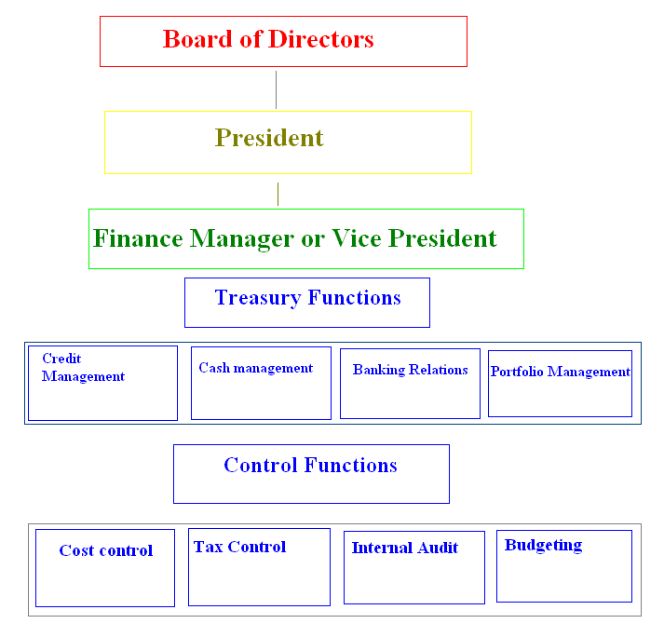
Organisation of finance function

Slide 9
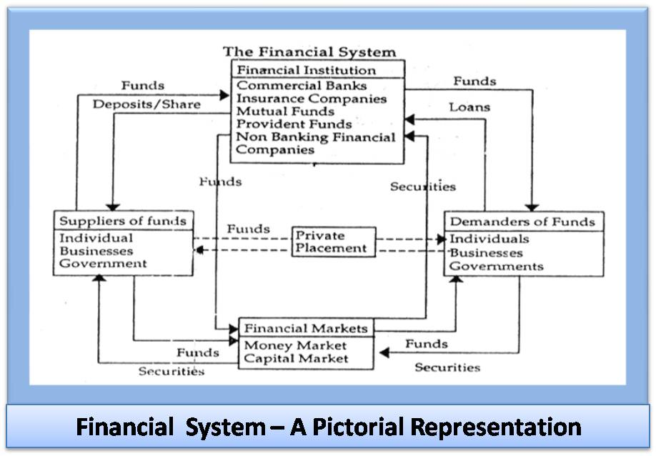
\

Slide 10
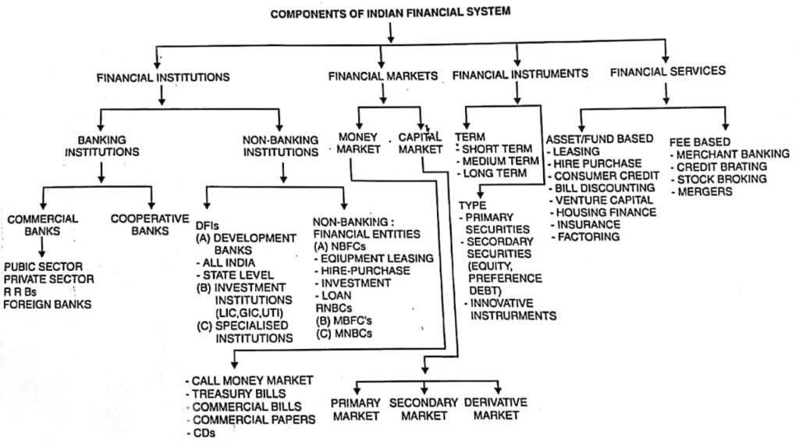

Slide 11
Functions of Financial system
Payment system-for the exchange of goods and services
Pooling of funds-for undertaking large scale enterprises
Transfer of resources

Slide 12
Financial Instruments
Coins, currency notes, demand deposits, corporate debentures, equity shares, futures and options
Financial assets/ financial liabilities
FA represents claim against future income and wealth of others.
FL represent promises to pay some proportion of prospective income and wealth to others

Slide 13
FA & FL
Money-
issued by RBI & Ministry of finance
Demand deposit-
promise to repay given sum as and when demanded by the holder. Interest Y/N
Short term debt-
promise to repay given sum with interest within period of 1 year
Intermediate term debt-
promise to repay given sum with interest within period that exceeds 1 year but is less than 5 years
Long term debt-
stream of interest over long period of time and then repay in lumpsum /installment
Equity stocks/ Preference Share
Bond/Debentures

Slide 14
Financial Markets
Money market
Call Money
Treasury Bill
Commercial bill
Commercial Paper
CDs.
Capital market
Primary market
Public issue
Right issue
Private placement
Secondary market
Government Securities market

Slide 15
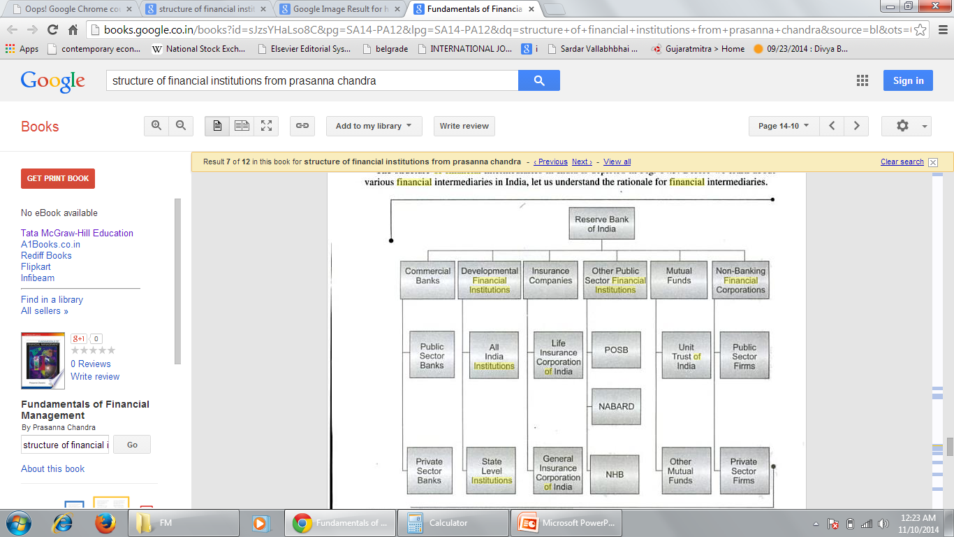
Financial Institutions

